Slide 1
CAREER PATHS
& CLASS RETROSPECTIVE
Reid Offringa, PhD
Data Scientist, Glooko

Slide 2
THE FIRST 5 WEEKS
Experimental Design
Inferential statistics
t-tests
p-values
Distributions
Modeling
Linear regression
Logistic Regression
KNN
Random forests

Slide 3
THE LAST 4 WEEKS
Natural Language Processing
Stemming / lemmatization
Vectorizors!
LSA / LDA
DIMENSION reduction
Cluster analysis
Latent variables
PCA
Timeseries
Your projects!

Slide 4
Types of Machine Learning Problems
Continuous
Categorical
Supervised
Regression
Classification
PCA /
Factor analysis
Clustering
Unsupervised

Slide 5
STUFF YOU CAN DO
QUESTIONS YOU CAN NOW ANSWER

Slide 6
DATA SCIENCE QUESTIONS
How much? How many?
Regression
What will the temperature be next Tuesday?
What will the fourth quarter sales be in Sacramento?
How high will my blood sugar be, if I eat this donut?
Linear Regression
Ridge / Lasso
Random Forest Regression
Notes:
Show of hands, who is strong in Business; ML; Math; Programming; Statistics
These roles prioritize different skill sets.
However, all roles involve some part of each skillset.
Where are your strengths and weaknesses?

Slide 7
DATA SCIENCE QUESTIONS
Is it A, B or C?
Classification
Will this person default on their loan?
Is this an image of a man or a dog?
Will this person click on an advertisement?
Is this mole malignant or benign?
K-Nearest Neighbors
Logistic Regression
Random Forest Classifier
Notes:
Show of hands, who is strong in Business; ML; Math; Programming; Statistics
These roles prioritize different skill sets.
However, all roles involve some part of each skillset.
Where are your strengths and weaknesses?

Slide 8
DATA SCIENCE QUESTIONS
What’s the structure of these Data?
Dimension Reduction
What are the different types of coffee drinkers?
Are there common clusters of cable channel viewership?
What are the different risk profiles of people with diabetes?
K-means clustering
Latent Class Analysis
EM / Gaussian mixture
LSA / LDA
PCA
Notes:
Show of hands, who is strong in Business; ML; Math; Programming; Statistics
These roles prioritize different skill sets.
However, all roles involve some part of each skillset.
Where are your strengths and weaknesses?

Slide 9
INTRODUCTION
THE DATA SCIENCE WORKFLOW

Slide 10
OVERVIEW OF THE DATA SCIENCE WORKFLOW
You can now produce reliable and reproducible results!
Reliable:
You can fine tune your models!
Reproducible:
Others can follow your steps and get the same results
Your jupyter notebooks save your code!

Slide 11
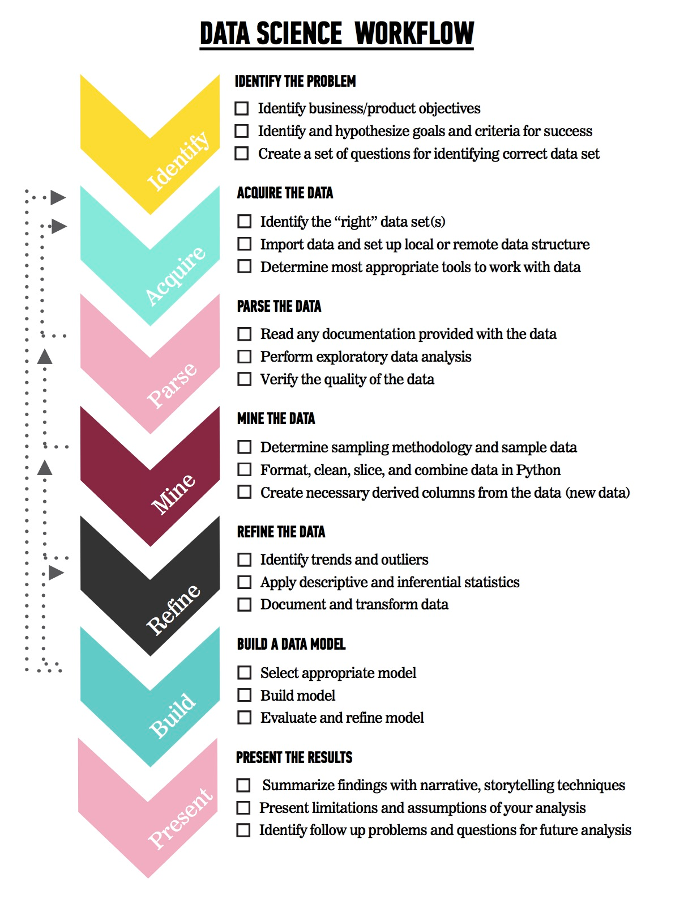
OVERVIEW OF THE DATA SCIENCE WORKFLOW
The steps:
Identify the problem
Acquire the data
Parse the data
Mine the data
Refine the data
Build a data model
Present the results
Notes:
I’ll go over this briefly - what would you like me to speak more about?

Slide 12
DATA SCIENCE
CAREER PATHS IN DATA SCIENCE

Slide 13
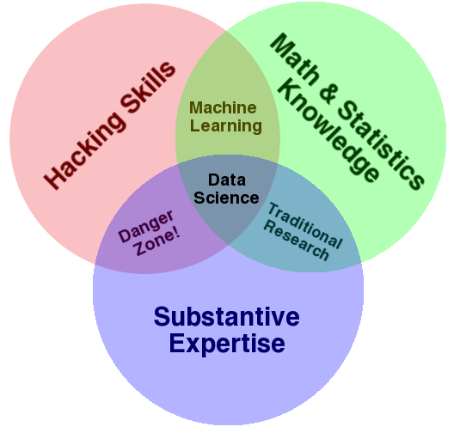
WHAT IS DATA SCIENCE?
Notes:
A very special set of skills…
For extracting meaning from data
Stretches across disciplines
Application of scientific techniques to
practical problems

Slide 14
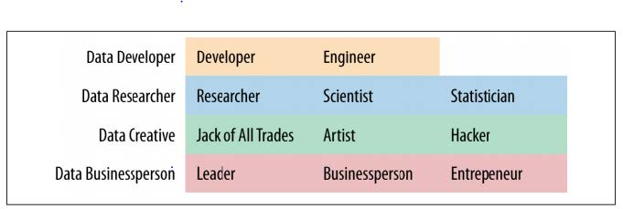
WHAT ARE THE ROLES IN DATA SCIENCE?
Data Science involves a variety of roles, not just one.

Slide 15
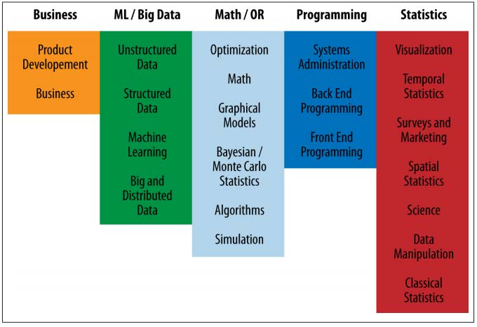
WHAT ARE THE ROLES IN DATA SCIENCE?
Data Science involves a variety of skill sets, not just one.

Slide 16
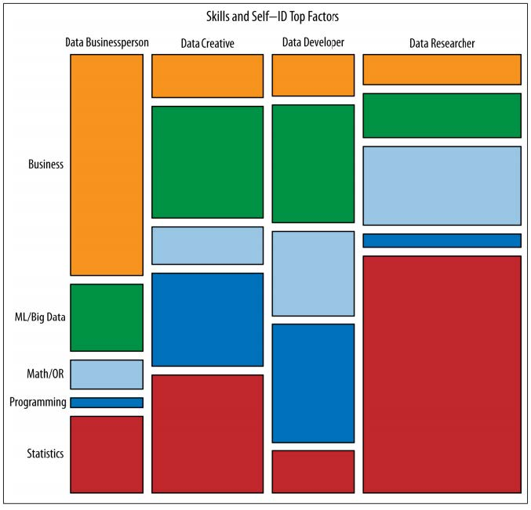
WHAT ARE THE ROLES IN DATA SCIENCE?
Notes:
Show of hands, who is strong in Business; ML; Math; Programming; Statistics
These roles prioritize different skill sets.
However, all roles involve some part of each skillset.
Where are your strengths and weaknesses?

